Slide 1

Introduction to
Deep Learning
0
8
Time to go deeper

Slide 2
8.1
What is Deep Learning?

Slide 3
Understanding Deep Learning
Deep Learning is a subset of Machine Learning, utilizing neural networks
Neural Networks replace the mathematical models we learned previously
Deep learning requires large volume of high-dimensional data
8.1. What is Deep Learning?

Slide 4
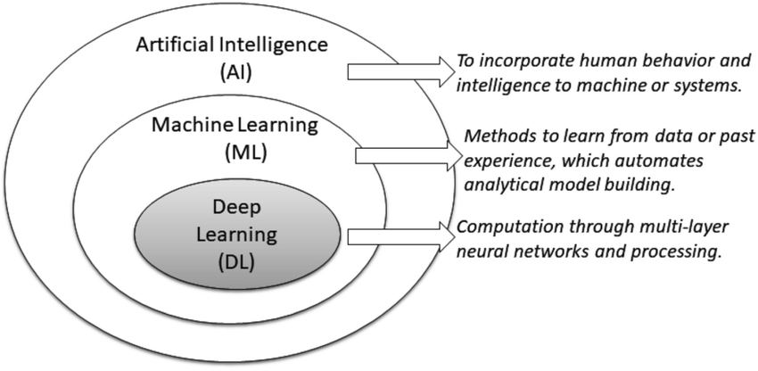
8.1. What is Deep Learning?

Slide 5
Why bother with Deep Learning?
Deep Learning can learn high-dimensional, unstructured data (images, texts, etc.)
Deep learning excel in complex tasks requiring hierarchical feature learning
8.1. What is Deep Learning?

Slide 6
When to avoid Deep Learning
When task is simple and structured enough for Machine Learning models
When computational resources are minimal
When model interpretation is required
8.1. What is Deep Learning?

Slide 7
8.2
Deep Learning Applications.

Slide 8
Places Deep Learning is being used today:
Image Recognition: Automating the process of identifying and detecting objects in images and videos.
Natural Language Processing: Understanding and generating human language, enabling applications such as chatbots and translation services.
8.2. Deep Learning Applications.

Slide 9
Places Deep Learning is being used today:
Healthcare: Assisting in diagnosis, personalized medicine, and drug discovery.
Autonomous Vehicles: Enabling self-driving cars to navigate and understand their environment.
Finance: Fraud detection, credit scoring, and algorithmic trading.
8.2. Deep Learning Applications.

Slide 10
8.3
Neural Networks.

Slide 11
What are Neural Networks?
Neural Networks are the backbone of Deep Learning
These are mathematical model based on human brain structure
At a high level these consists of:
Nodes/Neurons which host a value
Connections from one node to another
8.3. Neural Networks.

Slide 12
What are Neural Networks?
Neural Networks are the backbone of Deep Learning
These are mathematical model based on human brain structure
At a high level these consists of:
Nodes/Neurons which host a value
Connections from one node to another
8.3. Neural Networks.

Slide 13
Basic Components of a Neural Network
Neurons: Fundamental units of a neural network that receive input and pass the output to the next layer after computation.
Weights: Parameters within the network that transform input data within the network's layers.
Biases: Additional parameters that enable the model to adjust its output accordingly.
Activation Functions: Determine if a neuron should be activated or not, influencing the model's output.
8.3. Neural Networks.

Slide 14
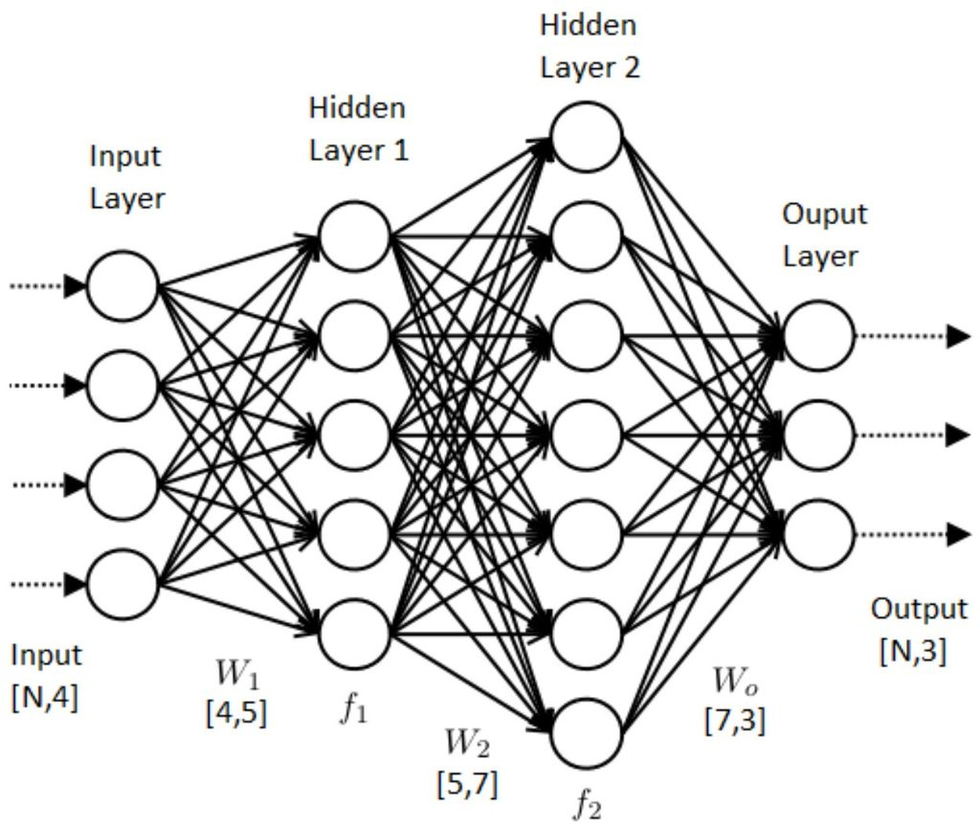
8.3. Neural Networks.

Slide 15
8.4
Machine Learning
or Deep Learning?

Slide 16
Issue 1
Problem Statement: Companies are facing challenges in efficiently sorting through large volumes of customer reviews and feedback to identify areas of improvement and customer satisfaction.
Solution Label: Natural Language Processing (Deep Learning)
8.4. Machine Learning or Deep Learning?

Slide 17
Issue 2
Problem Statement: Financial institutions need a robust method to predict credit default risks based on historical transaction data and customer profiles to minimize financial losses.
Solution Label: Supervised Machine Learning
8.4. Machine Learning or Deep Learning?

Slide 18
Issue 3
Problem Statement: E-commerce platforms are struggling to provide personalized product recommendations to users, which is essential for enhancing user experience and boosting sales
Solution Label: Collaborative Filtering (Machine Learning)
8.4. Machine Learning or Deep Learning?

Slide 19
Issue 4
Problem Statement: Manufacturers need an effective solution for detecting defects and anomalies in products on the production line to ensure quality and reduce waste
Solution Label: Convolutional Neural Networks (Deep Learning)
8.4. Machine Learning or Deep Learning?

Slide 20
Issue 5
Problem Statement: Environmental scientists require an efficient method to predict air quality levels in urban areas based on various atmospheric and weather-related parameters to issue timely alerts
Solution Label: Regression Analysis (Machine Learning)
8.4. Machine Learning or Deep Learning?

Slide 21
To understand the math behind deep learning
But what is a neural network? | Chapter 1, Deep learning
Gradient descent, how neural networks learn | Chapter 2, Deep learning
What is backpropagation really doing? | Chapter 3, Deep learning
Backpropagation calculus | Chapter 4, Deep learning
4.2. Statistical Machine Learning.
Further Study

Slide 22
END.

